Slide 1
NICILT Conference ‘Languages for Careers’ QUB, 4th March 2016
Ciarán Mac Giolla Bhéin
Advocacy Manager
Conradh na Gaeilge

Slide 2
Irish – influence and significance
Placenames – 95% are English versions of Irish names – Derry, Belfast, Ballymena, Newry
Schools – 5,000+ children attending IME and 1,000’s being taught Irish in English medium sector
Census figures – 12% - likely to increase
Global economy – plura-lingualism and multilingualism – early bilingualism as bedrock

Slide 3
Advantages
hot-wired to learn Irish; very high levels of fluency possible
I’ve been up since the scrake of dawn.
He’s here every Monday.
Have you brought your coat?
He broke the front window on me.
Words from Irish commonly used in English:
Smidiríní- Smithereens
Bróg - Brogue
Go leor – Galore
Craic – Crack
Is maith sin – Smashing
Gob - Gub
An dtuigeann tú – You dig!

Slide 4
Opportunities
Value placed on languages – plurilingualism, multilingualism
Public Perception – Increasing positive attitudes to the Irish language
Vibrant and growing social community of Irish speakers
All-Island Context & Links with other celtic language communities in Scotland, Wales etc…

Slide 5
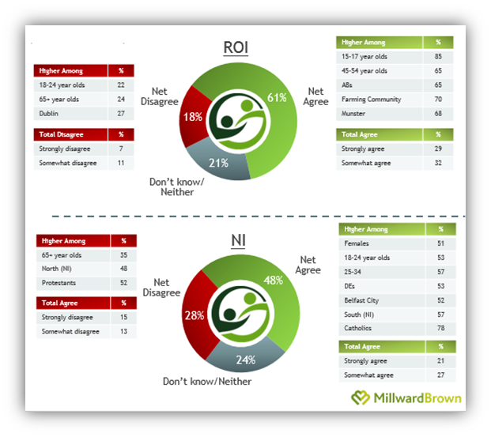
Attitudes to Irish Language
Should state do more to support the Language?
Should services through Irish be available to those who want them?

Slide 6
Employment opportunities
Working language of European Union
Increased funding and demand for services – Youth sector as an example
Television and media
Schools and colleges
Transferable skills
Historical research
Irish is only spoken in Ireland

Slide 7
Go raibh maith agaibh
Thank You

